Slide 1
Overview
Instruction Codes
Computer Registers
Computer Instructions
Timing and Control
Instruction Cycle
Memory Reference Instructions
Input-Output and Interrupt
Complete Computer Description

Slide 2
Introduction
Every different processor type has its own design (different registers, buses, micro-operations, machine instructions, etc)
Modern processor is a very complex device
It contains
  Many registers
  Multiple arithmetic units, for both integer and floating point calculations
  The ability to pipeline several consecutive instructions to speed execution
  Etc.
However, to understand how processors work, we will start with a simplified processor model

Slide 3
Basic Computer
The Basic Computer has two components, a processor and memory
The memory has 4096 words in it
  4096 = 2¹², so it takes 12 bits to select a word in memory
Each word is 16 bits long
CPU
RAM
0
4095
15
0

Slide 4
Instruction
Program
  A sequence of (machine) instructions
(Machine) Instruction
  A group of bits that tell the computer to perform a specific operation (a sequence of micro-operation)
The instructions of a program, along with any needed data are stored in memory
The CPU reads the next instruction from memory
It is placed in an Instruction Register (IR)
Control circuitry in control unit then translates the instruction into the sequence of microoperations necessary to implement it

Slide 5
Instruction Format
A computer instruction is often divided into two parts
  An opcode (Operation Code) that specifies the operation for that instruction
  An address that specifies the registers and/or locations in memory to use for that operation
In the Basic Computer, since the memory contains 4096 (= 2¹²) words, we needs 12 bit to specify which memory address this instruction will use
In the Basic Computer, bit 15 of the instruction specifies the addressing mode (0: direct addressing, 1: indirect addressing)
Since the memory words, and hence the instructions, are 16 bits long, that leaves 3 bits for the instruction’s opcode
Instruction Format
15
14
12
11
0
I
Opcode
Address
Addressing
mode

Slide 6
Addressing Mode
The address field of an instruction can represent either
  Direct address: the address in memory of the data to use (the address of the operand), or
  Indirect address: the address in memory of the address in memory of the data to use
Effective Address (EA)
  The address, that can be directly used without modification to access an operand for a computation-type instruction, or as the target address for a branch-type instruction
Direct addressing
Indirect addressing
22
0
ADD
457
35
1
ADD
300
300
1350
457
Operand
1350
Operand
+
+
AC
AC

Slide 7
Processor Register
A processor has many registers to hold instructions, addresses, data, etc
The processor has a register, the Program Counter (PC) that holds the memory address of the next instruction to get
  Since the memory in the Basic Computer only has 4096 locations, the PC only needs 12 bits
In a direct or indirect addressing, the processor needs to keep track of what locations in memory it is addressing: The Address Register (AR) is used for this
  The AR is a 12 bit register in the Basic Computer
When an operand is found, using either direct or indirect addressing, it is placed in the Data Register (DR). The processor then uses this value as data for its operation
The Basic Computer has a single general purpose register – the Accumulator (AC)

Slide 8
Processor Register
The significance of a general purpose register is that it can be referred to in instructions
  e.g. load AC with the contents of a specific memory location; store the contents of AC into a specified memory location
Often a processor will need a scratch register to store intermediate results or other temporary data; in the Basic Computer this is the Temporary Register (TR)
The Basic Computer uses a very simple model of input/output (I/O) operations
  Input devices are considered to send 8 bits of character data to the processor
  The processor can send 8 bits of character data to output devices
The Input Register (INPR) holds an 8 bit character gotten from an input device
The Output Register (OUTR) holds an 8 bit character to be send to an output device

Slide 9
Processor Register
Registers in the Basic Computer
11
0
PC
Memory
11
0
4096 x 16
AR
15
0
IR
CPU
15
0
15
0
TR
DR
7
0
7
0
15
0
OUTR
INPR
AC
List of BC Registers
  DR 16 Data Register Holds memory operand
  AR 12 Address Register Holds address for memory
  AC 16 Accumulator Processor register
  IR 16 Instruction Register Holds instruction code
  PC 12 Program Counter Holds address of instruction
  TR 16 Temporary Register Holds temporary data
  INPR 8 Input Register Holds input character
  OUTR 8 Output Register Holds output character

Slide 10
Common Bus System
The registers in the Basic Computer are connected using a bus
This gives a savings in circuitry over complete connections between registers

Slide 11
Common Bus System
S1
Bus
S0
Memory unit
7
4096 x 16
Address
Write
Read
AR
1
LD INR CLR
PC
2
LD INR CLR
DR
3
LD INR CLR
E
ALU
AC
4
LD INR CLR
INPR
IR
5
LD
TR
6
LD INR CLR
OUTR
Clock
LD

Slide 12
Common Bus System
Three control lines, S₂, S₁, and S₀ control which register the bus selects as its input
Either one of the registers will have its load signal activated, or the memory will have its read signal activated
  Will determine where the data from the bus gets loaded
The 12-bit registers, AR and PC, have 0’s loaded onto the bus in the high order 4 bit positions
When the 8-bit register OUTR is loaded from the bus, the data comes from the low order 8 bits on the bus
S₂ S₁ S₀ Register
0 0 0 x
0 0 1 AR
0 1 0 PC
0 1 1 DR
1 0 0 AC
1 0 1 IR
1 1 0 TR
1 1 1 Memory

Slide 13
LD: enables the input of a register to the common bus. When LD=1 for a register the data on the common bus is read into the register during the next clock pulse transition
INR: increment the content of register
CLR: clear the content of register to zero

Slide 14
Basic Computer Instructions
Basic Computer Instruction Format
1. Memory-Reference Instructions (OP-code = 000 ~ 110)
15 14
12 11
0
I
Opcode
Address
2. Register-Reference Instructions (OP-code = 111, I = 0)
15
12 11
0
0 1 1 1
Register operation
3. Input-Output Instructions (OP-code =111, I = 1)
15
12 11
0
1 1 1 1
I/O operation

Slide 15
Basic Computer Instructions
Hex Code
Symbol I = 0 I = 1 Description
  AND 0xxx 8xxx AND memory word to AC
  ADD 1xxx 9xxx Add memory word to AC
  LDA 2xxx Axxx Load AC from memory
  STA 3xxx Bxxx Store content of AC into memory
  BUN 4xxx Cxxx Branch unconditionally
  BSA 5xxx Dxxx Branch and save return address
  ISZ 6xxx Exxx Increment and skip if zero
  CLA 7800 Clear AC
  CLE 7400 Clear E
  CMA 7200 Complement AC
  CME 7100 Complement E
  CIR 7080 Circulate right AC and E
  CIL 7040 Circulate left AC and E
  INC 7020 Increment AC
  SPA 7010 Skip next instr. if AC is positive
  SNA 7008 Skip next instr. if AC is negative
  SZA 7004 Skip next instr. if AC is zero
  SZE 7002 Skip next instr. if E is zero
  HLT 7001 Halt computer
  INP F800 Input character to AC
  OUT F400 Output character from AC
  SKI F200 Skip on input flag
  SKO F100 Skip on output flag
  ION F080 Interrupt on
  IOF F040 Interrupt off

Slide 16
Instruction Set Completeness
A computer should have a set of instructions so that the user can construct machine language programs to evaluate any function that is known to be computable.
Instruction Types
  Functional Instructions
  - Arithmetic, logic, and shift instructions
  - ADD, CMA, INC, CIR, CIL, AND, CLA
  Transfer Instructions
  - Data transfers between the main memory and the processor registers
  - LDA, STA
  Control Instructions
  - Program sequencing and control
  - BUN, BSA, ISZ
  Input/output Instructions
  - Input and output
  - INP, OUT

Slide 17
Timing & Control
The timing for all registers in the basic computer is controlled by a master clock generator
The clock pulses are applied to all flip-flops and registers in the system, including the flip-flops and registers in the control unit
The clock pulses do not change the state of a register unless the register is enabled by a control signal (i.e., Load)

Slide 18
Control Unit
Control unit (CU) of a processor translates from machine instructions to the control signals for the micro-operations that implement them
The control signals are generated in the control unit and provide control inputs for the multiplexers in the common bus, control inputs in processor registers, and micro-operations for the accumulator
Control units are implemented in one of two ways
Hardwired Control
  CU is made up of sequential and combinational circuits to generate the control signals
Microprogrammed Control
  A control memory on the processor contains microprograms that activate the necessary control signals

Slide 19
Timing & Control
In the hardwired organization, the control logic is implemented with gates, flip-flops, decoders, and other digital circuits.
In the microprogrammed organization, the control information is stored in a control memory (if the design is modified, the microprogram in control memory has to be updated)
D₃T₄: SC←0

Slide 20
Timing and Control
Control unit of Basic Computer
Instruction register (IR)
15
14 13 12
11 - 0
Other inputs
3 x 8
decoder
7 6 5 4 3 2 1 0
D
0
Combinational
Control
logic
I
D
Control
signals
7
T
15
T
0
15 14 . . . . 2 1 0
4 x 16
decoder
4-bit
Increment (INR)
sequence
Clear (CLR)
counter
Clock
(SC)

Slide 21
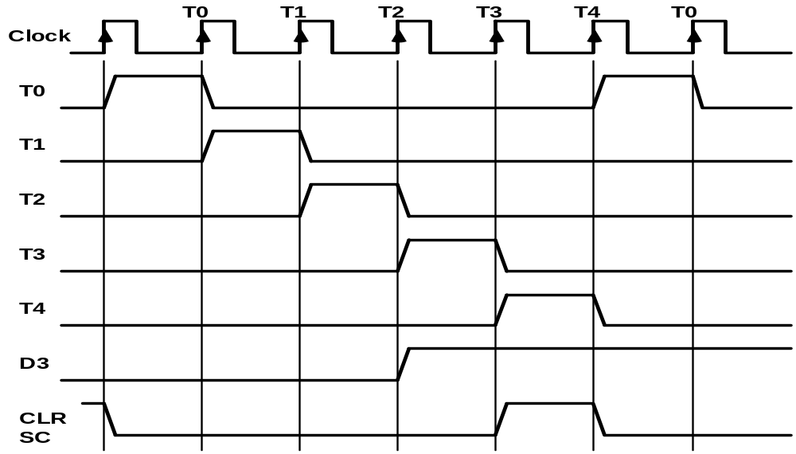
Timing Signals
- Generated by 4-bit sequence counter and 4×16 decoder
- The SC can be incremented or cleared.
- Example: T₀, T₁, T₂, T₃, T₄, T₀, T₁, . . .
Assume: At time T₄, SC is cleared to 0 if decoder output D3 is active.
D₃T₄: SC ← 0

Slide 22
Timing & Control
A memory read or write cycle will be initiated with the rising edge of a timing signal
Assume: memory cycle time < clock cycle time!
So, a memory read or write cycle initiated by a timing signal will be completed by the time the next clock goes through its positive edge
The clock transition will then be used to load the memory word into a register
The memory cycle time is usually longer than the processor clock cycle → wait cycles

Slide 23
Timing & Control
T₀: AR←PC
  Transfers the content of PC into AR if timing signal T₀ is active
  T₀ is active during an entire clock cycle interval
  During this time, the content of PC is placed onto the bus (with S₂S₁S₀=010) and the LD (load) input of AR is enabled
  The actual transfer does not occur until the end of the clock cycle when the clock goes through a positive transition
  This same positive clock transition increments the sequence counter SC from 0000 to 0001
  The next clock cycle has T₁ active and T₀ inactive

